Slide 1
Digital Transmission
Modulation Techniques

Slide 2
ANALOG-TO-DIGITAL CONVERSION
A digital signal is superior to an analog signal because it is more robust to noise and can easily be recovered, corrected and amplified. For this reason, the tendency today is to change an analog signal to digital data. In this section we describe two techniques, pulse code modulation and delta modulation.
Topics discussed in this section:
Pulse Code Modulation (PCM)
Delta Modulation (DM)

Slide 3
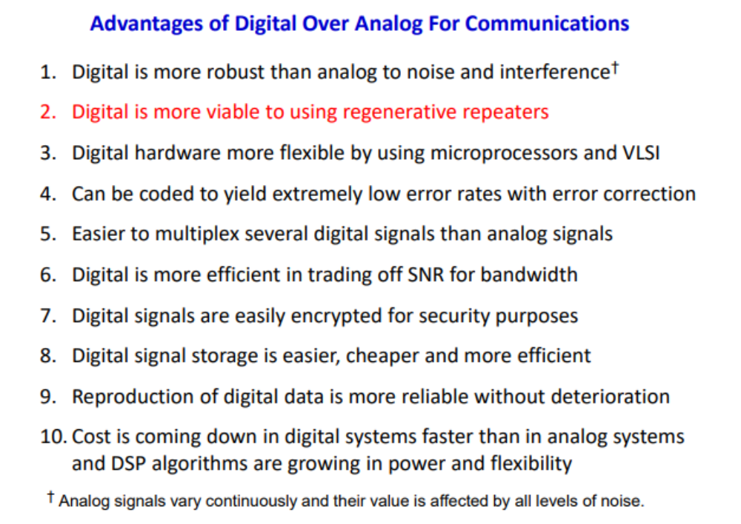

Slide 4
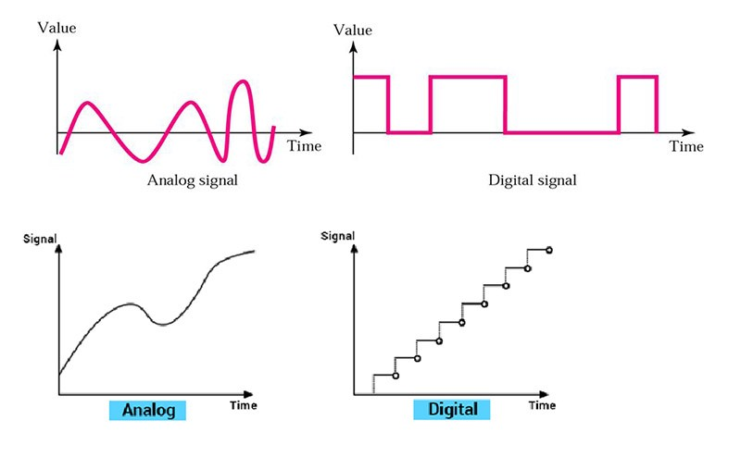

Slide 5
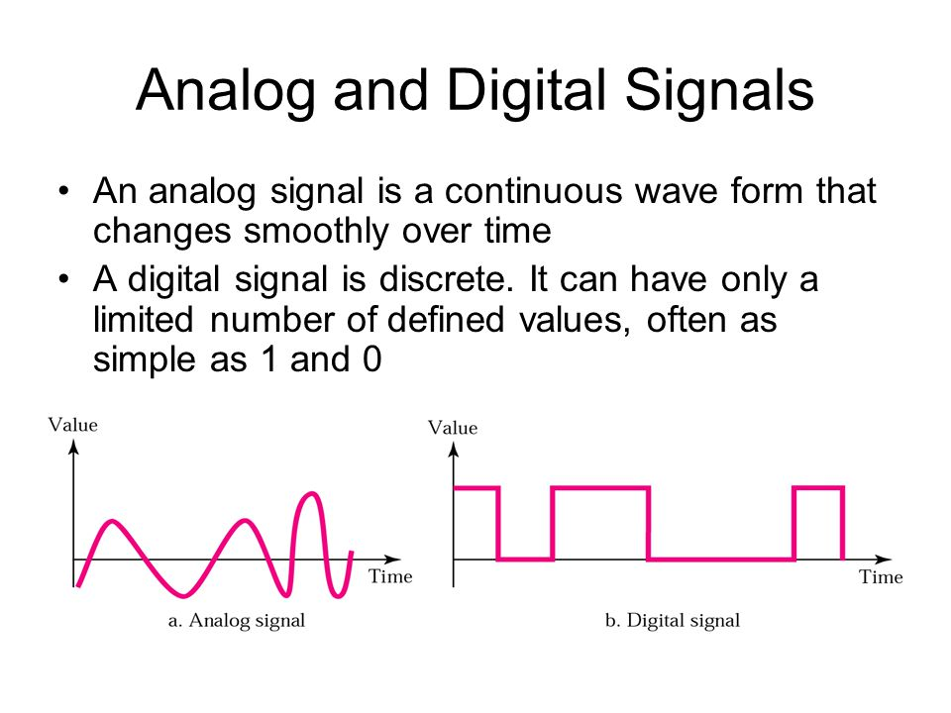

Slide 6
PCM
PCM consists of three steps to digitize an analog signal:
  Sampling
  Quantization
  Binary encoding
Before we sample, we have to filter the signal to limit the maximum frequency of the signal as it affects the sampling rate.
Filtering should ensure that we do not distort the signal, ie remove high frequency components that affect the signal shape.

Slide 7
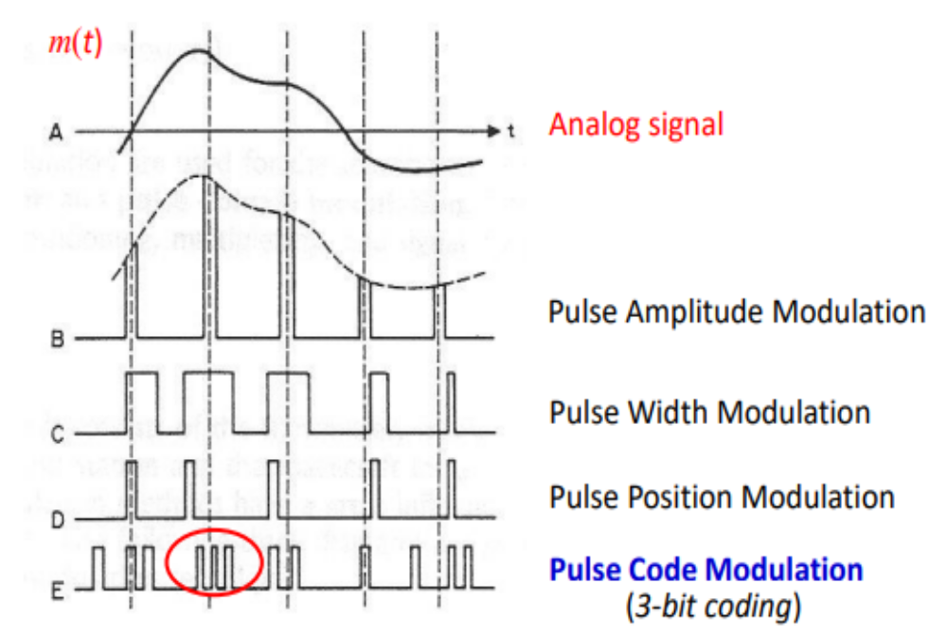

Slide 8
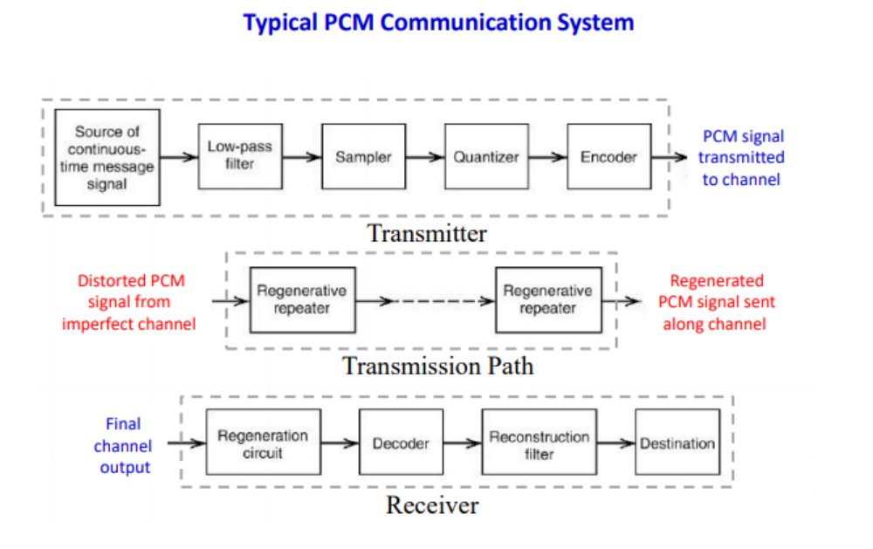

Slide 9
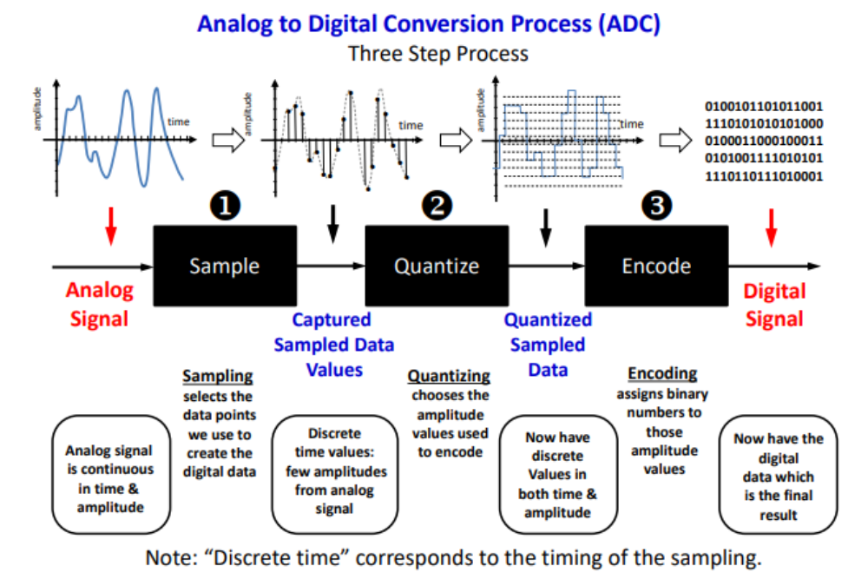

Slide 10
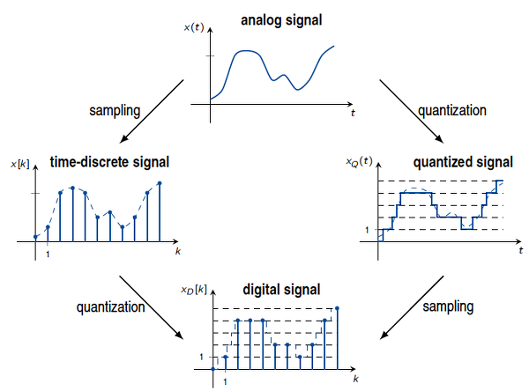

Slide 11

Components of PCM encoder

Slide 12

Three different sampling methods for PCM

Slide 13
PCM Decoder
To recover an analog signal from a digitized signal we follow the following steps:
  We use a hold circuit that holds the amplitude value of a pulse till the next pulse arrives.
  We pass this signal through a low pass filter with a cutoff frequency that is equal to the highest frequency in the pre-sampled signal.
The higher the value of L, the less distorted a signal is recovered.

Slide 14

Components of a PCM decoder

Slide 15
Delta Modulation
This scheme sends only the difference between pulses, if the pulse at time t_{n+1} is higher in amplitude value than the pulse at time t_{n}, then a single bit, say a “1”, is used to indicate the positive value.
If the pulse is lower in value, resulting in a negative value, a “0” is used.
This scheme works well for small changes in signal values between samples.
If changes in amplitude are large, this will result in large errors.

Slide 16

The process of delta modulation

Slide 17

Delta modulation components

Slide 18

Delta demodulation components

Slide 19
TRANSMISSION MODES
The transmission of binary data across a link can be accomplished in either parallel or serial mode. In parallel mode, multiple bits are sent with each clock tick. In serial mode, 1 bit is sent with each clock tick. While there is only one way to send parallel data, there are three subclasses of serial transmission: asynchronous, synchronous, and isochronous.
Topics discussed in this section:
Parallel Transmission
Serial Transmission

Slide 20

Data transmission and modes

Slide 21

Parallel transmission

Slide 22

Serial transmission

Slide 23

Note
In asynchronous transmission, we send 1 start bit (0) at the beginning and 1 or more stop bits (1s) at the end of each byte. There may be a gap between
each byte.

Slide 24
Note
Asynchronous here means “asynchronous at the byte level,”
but the bits are still synchronized;
their durations are the same.

Slide 25

Asynchronous transmission

Slide 26
Note
In synchronous transmission, we send bits one after another without start or stop bits or gaps. It is the responsibility of the receiver to group the bits. The bits are usually sent as bytes and many bytes are grouped in a frame. A frame is identified with a start and an end byte.

Slide 27

Synchronous transmission

Slide 28
Isochronous
In isochronous transmission we cannot have uneven gaps between frames.
Transmission of bits is fixed with equal gaps.

